Slide 1

YBFMP test-case
Brittany Davis – DWR
DUWG OpenScience & Metadata Joint Subcommittee Meeting
July 27, 2018

Slide 2
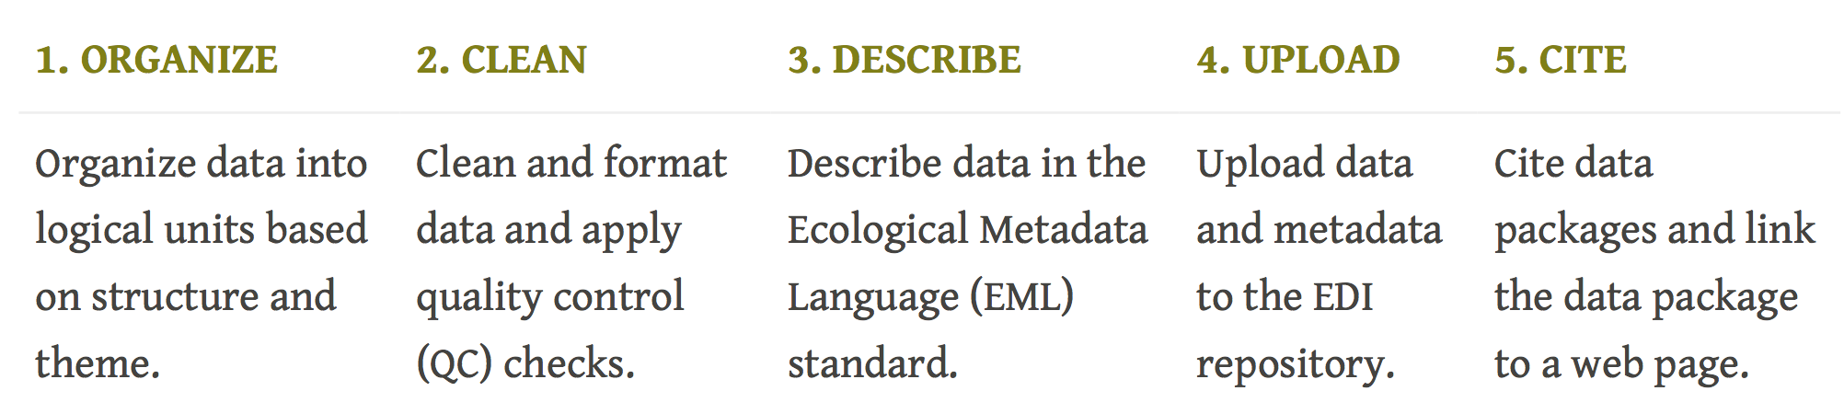
5 steps to publishing data on EDI
Data Development
Staging
Publish
EMLassemblyLine

Slide 3
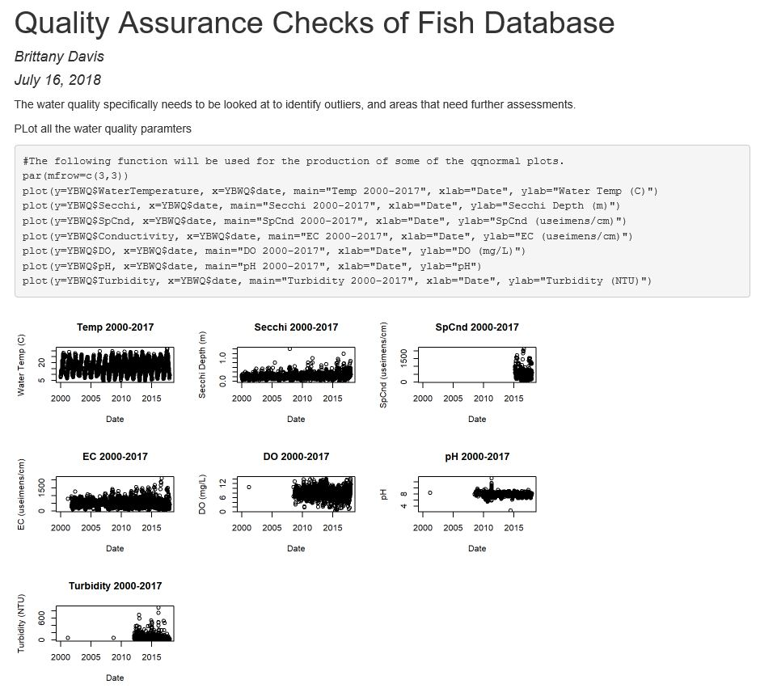
Data: QA/QC
Visual Inspections for outliers
Comparisons to nearest real-time data (Lisbon sonde)
Data cleaning and corrections

Slide 4
YouTube video & Github resources
EMLassemblyLine
The EDI metadata template (55 min)
What are metadata and metadata structures? (1:12 h)
Make metadata with EML assembly line (43 min)
Clean taxonomy data with taxonomyCleanr R package (33 min)
(https://github.com/EDIorg/EMLassemblyline)
Notes:
Use the resources available
Process can be cyclical and actually help with additional QA checks, variables undefined, etc.

Slide 5
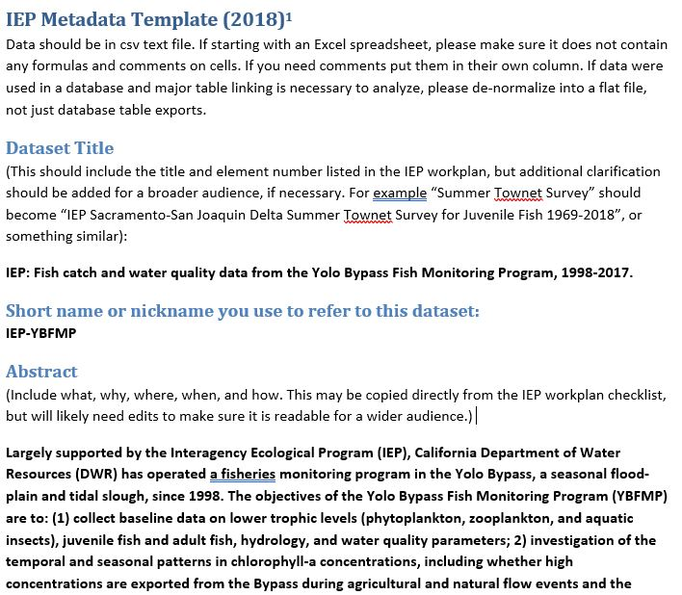
Development of Metadata
EDI metadata template with IEP alterations
Discuss changes to template based on EDIassemblyline, other uploads, and reduce complexity.
16 steps of EMLassemblyLine

Slide 6
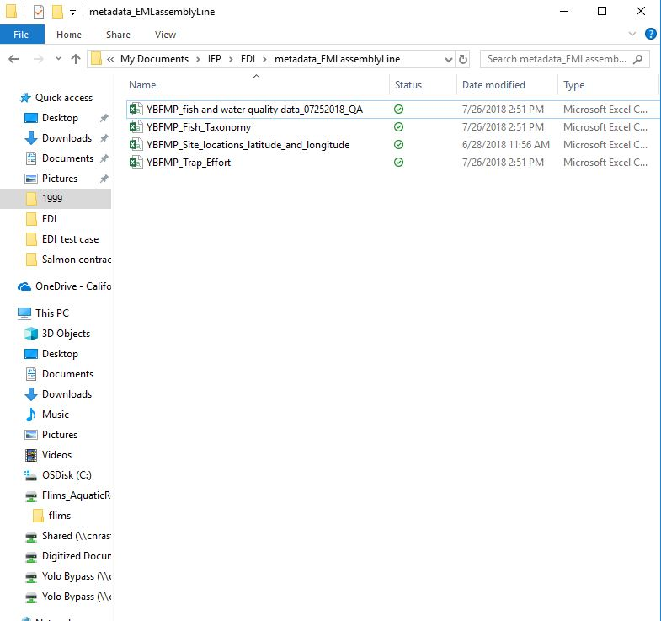
Development: EMLassemblyLine in R
Step 1: Create a working directory for dataset
Step 2: Move your dataset to the directory
Should be final tables ready to publish
Notes:
This is where the metadata parts created in the assembly line process will be stored and available for editing should you need to change the content of your EML.
Name this directory after your dataset. Replace spaces with underscores (e.g. name of your directory should be name_of_your_directory).
*R does not communicate well with the OneDrive, consider working more easily on the Desktop.
These should be the final versions of the data you are ready to publish.

Slide 7
Development: EMLassemblyLine in R
Step 3: Select an Intellectual rights license
There are 2 options for intellectual rights licenses:
CC0 the most accomodating of data reuse ... This data package is released to the “public domain” under Creative Commons CC0 1.0 “No Rights Reserved” (see: https://creativecommons.org/publicdomain/zero/1.0/). It is considered professional etiquette to provide attribution of the original work if this data package is shared in whole or by individual components. A generic citation is provided for this data package on the website https://portal.edirepository.org (herein “website”) in the summary metadata page. Communication (and collaboration) with the creators of this data package is recommended to prevent duplicate research or publication. This data package (and its components) is made available “as is” and with no warranty of accuracy or fitness for use. The creators of this data package and the website shall not be liable for any damages resulting from misinterpretation or misuse of the data package or its components. Periodic updates of this data package may be available from the website. Thank you.
CCBY requires attribution ... This information is released under the Creative Commons license - Attribution - CC BY (https://creativecommons.org/licenses/by/4.0/). The consumer of these data ("Data User" herein) is required to cite it appropriately in any publication that results from its use. The Data User should realize that these data may be actively used by others for ongoing research and that coordination may be necessary to prevent duplicate publication. The Data User is urged to contact the authors of these data if any questions about methodology or results occur. Where appropriate, the Data User is encouraged to consider collaboration or co-authorship with the authors. The Data User should realize that misinterpretation of data may occur if used out of context of the original study. While substantial efforts are made to ensure the accuracy of data and associated documentation, complete accuracy of data sets cannot be guaranteed. All data are made available "as is." The Data User should be aware, however, that data are updated periodically and it is the responsibility of the Data User to check for new versions of the data. The data authors and the repository where these data were obtained shall not be liable for damages resulting from any use or misinterpretation of the data. Thank you.
Should IEP make a customized CC by statement?

Slide 8
Development: EMLassemblyLine in R
Step 4: Identify the types of data in your dataset
replace symbols with words
replace parentheses with underscores
replace periods with underscores
replace blank spaces with underscores
Notes:
Currently, the assembly line only works for tabular data and .zip directories.
table
A flat file composed of columns containing variables and rows containing observations. Column names must follow these rules:

Slide 9
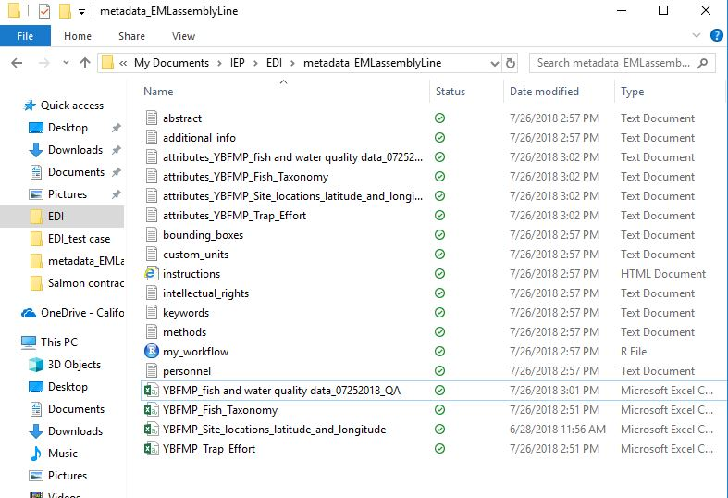
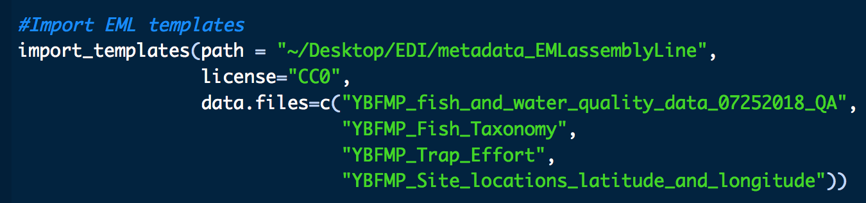
Development: EMLassemblyLine in R
Step 5: Import the core metadata templates
Step 6: Script your workflow
Notes:
Step 5: Import the core metadata templates
Run the function import_templates in the RStudio Console to populate the directory with metadata templates for you to complete. You will need to supply a few arguments to this function:
path A path to your dataset working directory.
license The license for your dataset ("CC0" or "CCBY").
data.files A list of the data tables of your dataset. File extension is not required. Do not include .zip directories here, they will be added in the make_eml step.
# First load the EMLassemblyline package
library(EMLassemblyline)
# View documentation for this function
?import_templates
# Import templates for an example dataset licensed under CC0, with 2 tables.
import_templates(path = "/Users/csmith/Desktop/gleon_chloride",
license = "CC0",
data.files = c("lake_chloride_concentrations",
"lake_characteristics"))
replace symbols with words
replace parentheses with underscores
replace periods with underscores
replace blank spaces with underscores
e.g. name.of.(your) d@t@.file should be name_of_your_data_file

Slide 10
Development: EMLassemblyLine in R
Step 7: Abstract
Copy/paste information from the word template
Notes:
Step 7: Abstract
Open the file abstract.txt and write an abstract for your dataset. The abstract should cover what, why, when, where, and how for your dataset. Write your abstract in plain text.
Do not use special characters, symbols, formatting, or hyperlinks (URLs are acceptable). The reason for this is that the EML schema only allows characters that are apart of the unicode character set.
NOTE: You can create your abstract in Microsoft Word and then copy over to abstract.txt but first you will need to remove any non-unicode characters. To do this go to this web service and paste your abstract into the window. Click the button "Remove Diacritics" to remove these non-compliant characters, then copy the resultant text into abstract.txt. You will want to give your abstract one last look over after performing this operation to ensure no information has been lost.

Slide 11
Development: EMLassemblyLine in R
Step 8: Methods – Follow IEP standards
1.) Data collection methods | Metadata must include enough information on methods to make the data usable. Minimum methods information should be similar to the "methods" section of a scientific paper. This may include diagrams and pictures of sampling equipment. | REQUIRED
2.) Link to blank datasheet | Available upon request (see data contact information) | REQUIRED – 3yrs
3.) Instrument and equipment specifications, includingQAQC methods and frequency | May be references to external SOPs instead of included in metadata | REQUIRED
4.) Analysis methods & SOPs | Any analyses done to produce the data set (such as CPUE calculations). This is not analyses done to produce later publications. Link to SOPS: Specific SOPs used to generate the data. It is understood that not all programs will have this information available right away, but should be prepared to provide them within three years. | REQUIRED
5.) Project history | List of any changes in methods and sampling locations, with dates changes were implemented | REQUIRED – If App.
6.) QA/QC – Methods & Data | Methods: Protocols for quality assurance during data collection Data: Protocols for quality assurance during data entry and analysis | REQUIRED – 3yrs
7.) Contractor information | Chain of custody procedures and contact information for any outside labs used to produce the data. | REQUIRED – If App.
8.) External review process | Any other review of data done by entities other than the PI to help with quality assurance. We just need a description of the process, not the reviews themselves | REQUIRED – If App.
9.) Methods references | Citations for publications from which methods were drawn. | REQUIRED – If App.
Notes:
Step 8: Methods
Open the file methods.txt and describe the methods for your dataset. Be specific, include instrument descriptions, or point to a protocol online. If this dataset is a synthesis of other datasets please specify dataset origins, preferably their DOI or URL plus general citation information.
Do not use special characters, symbols, formatting, or hyperlinks (URLs are acceptable). The reason for this is that the EML schema only allows characters that are apart of the unicode character set.
NOTE: You can create your methods in Microsoft Word and then copy over to methods.txt but first you will need to remove any non-unicode characters. To do this go to this web service and paste your methods into the window. Click the button "Remove Diacritics" to remove these non-compliant characters, then copy the resultant text into methods.txt. You will want to give your methods one last look over after performing this operation to ensure no information has been lost.

Slide 12
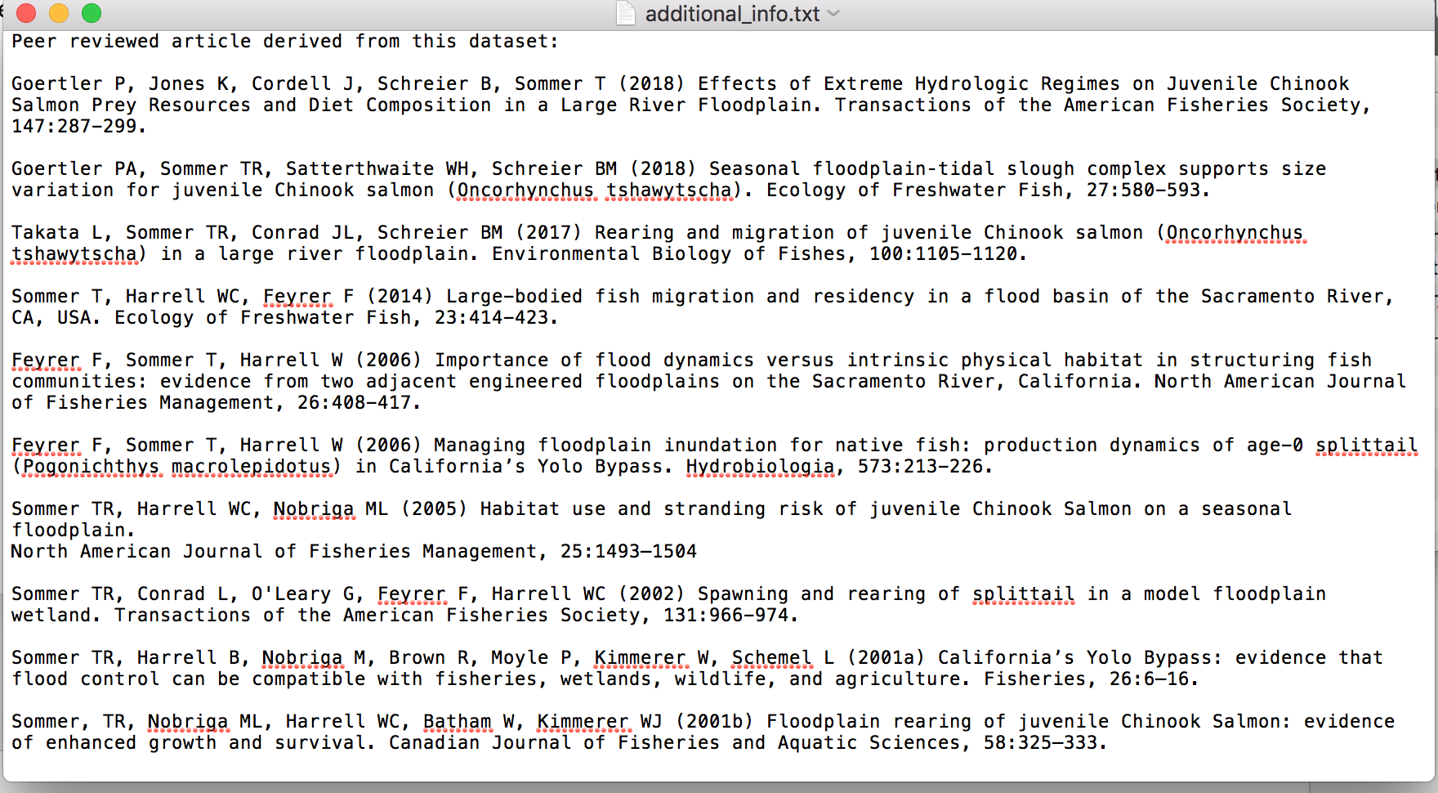
Development: EMLassemblyLine in R
Step 9: Additional Information
a list of research articles or theses derived from this dataset
Notes:
Step 9: Additional information
additional_info.txt is a good place for text based information about your dataset that doesn't fall under the scope of the abstract or methods (e.g. a list of research articles or theses derived from this dataset). If you have this information and would like to share it then open additional_info.txt in a text editor and add it. You can delete this file if you won't be using it, or you can keep it around in case you change your mind.
Do not use special characters, symbols, formatting, or hyperlinks (URLs are acceptable). The reason for this is that the EML schema only allows characters that are apart of the unicode character set.
NOTE: You can create your additional information in Microsoft Word and then copy over to additional_info.txt but first you will need to remove any non-unicode characters. To do this go to this web service and paste your additional information into the window. Click the button "Remove Diacritics" to remove these non-compliant characters, then copy the resultant text into additional_info.txt. You will want to give your additional information one last look over after performing this operation to ensure no information has been lost.
* I added a list of peer-reviewed literature that has already used this dataset that users can reference for additional details.

Slide 13
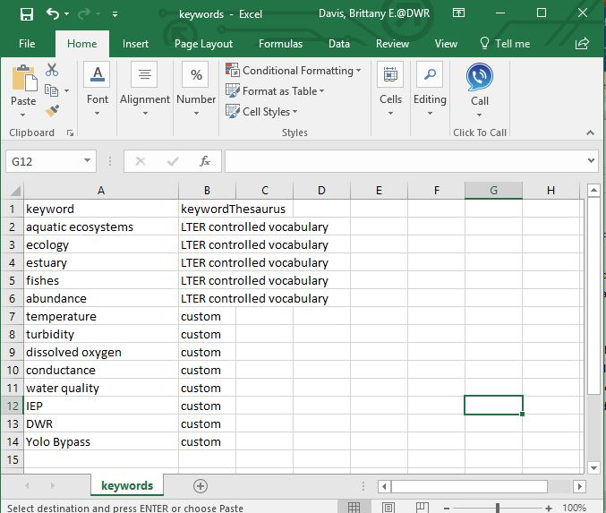
Development: EMLassemblyLine in R
Step 10: Keywords
Notes:
Step 10: Keywords
Open the tab delimited file keywords.txt in a spreadsheet editor and list the keywords that best describe your dataset. DO NOT edit this file in a text editor. Consult the LTER controlled vocabulary for keywords. In addition to keywords describing the data, you may want to include keywords that describe your lab, station, and project (e.g. OBFS, LTREB, etc.).
Definitions for columns of this file:
keyword A keyword describing your dataset.
keywordThesaurus A keywordThesaurus (i.e. a controlled vocabulary like the resource listed above) corresponding to the keyword listed in the keyword column. If the keyword is not from a thesaurus or controlled vocabulary, leave corresponding entry in the keywordThesaurus column blank.
*If you include a set of your own keywords and descriptors, you need to add “custom” or something other to the keywordThesaurus column. You will receive an ERROR in the xml compilation if cells left empty.

Slide 14
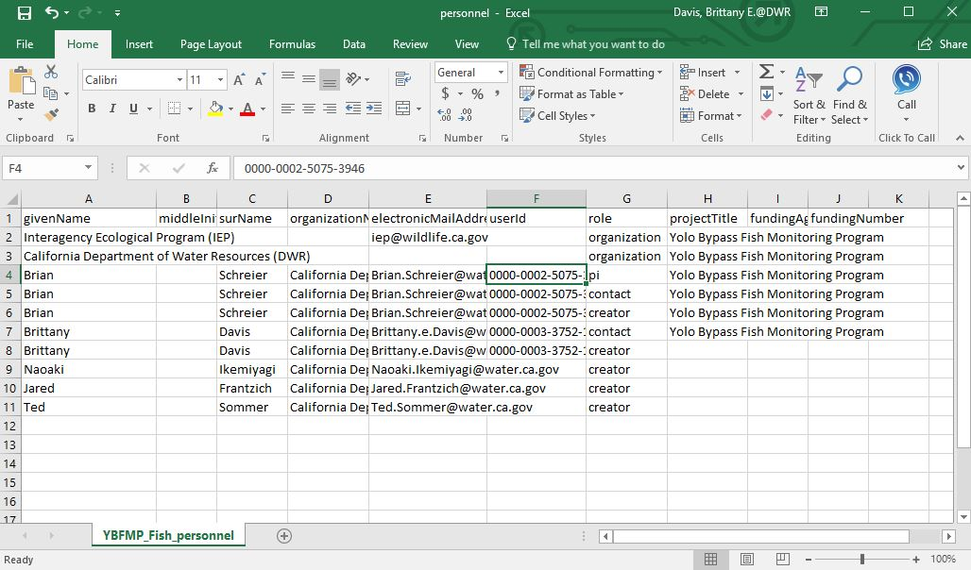

Development: EMLassemblyLine in R
Step 11: Personnel
Notes:
Step 11: Personnel
Open the tab delimited file personnel.txt in a spreadsheet editor and enter information about the personnel associated with this dataset.
Definitions for columns of this file:
givenName First name of person.
middleInitial Middle initial of person.
surName Last name of person.
organizationName Name of organization the person is associated with.
electronicMailAddress Email address of person.
userId ORCID of person (not required). A valid entry for userId is the 16 digit ORCID number separated by dashes (i.e. XXXX-XXXX-XXXX-XXXX). An ORCID is like a social security number for scientists and links your dataset with your ORCID. Create one here.
role Role of person with respect to this dataset. Valid entries for role are:
creator Dataset creator (required; at least 1 creator must be listed for your dataset).
PI Principal investigator associated with this dataset (not required).
contact Dataset contact (required; at least 1 contact must be listed for your dataset). The contact may be a person or a position at an organization. We recommend listing the contact as a person rather than a position. To list a position as a contact (e.g. Data Manager), Enter the position name in the givenName column and leave middleInitial and surName blank.
Any other entries into the 'role' column are acceptable and will be defined under the associated party element of this dataset with whatever value is entered under role.
If a person serves more than one role, duplicate this persons information in another row but with the additional role.
Similarly if a role is shared among many people, list the individuals with the shared role on separate lines.
projectTitle Title of the project this dataset was created under (optional). Project titles are only listed on lines where the personnel role is PI. If an auxiliary project was involved in creating this dataset then add a new row below the row containing the primary project and list the project title and associated PI. Do this for each auxiliary project.
fundingAgency Name of the entity funding the creation of this dataset (optional). Only include an entry in this column for rows where role PI.
fundingNumber Number of the grant or award that supported creation of this dataset (optional). Only include an entry in this column for rows where role PI.

Slide 15
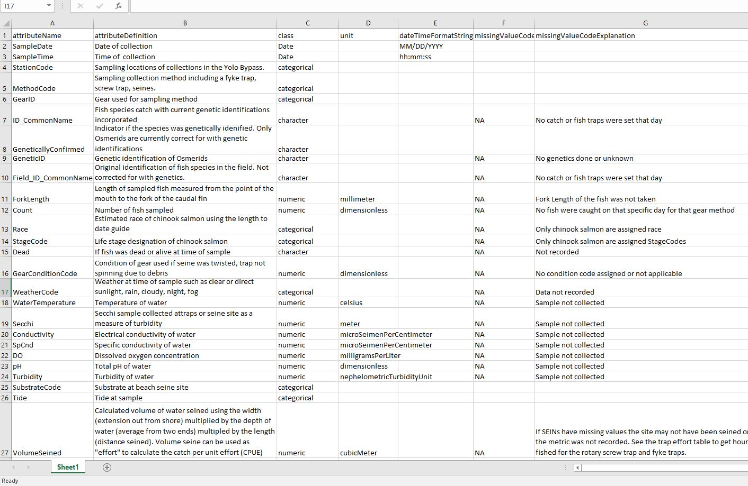
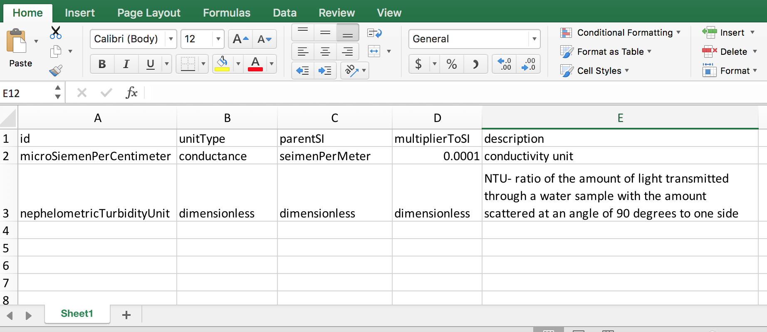
Development: EMLassemblyLine in R
Step 12: Attributes
Fish & water quality table
Custom units
View unit dictionary in R
Notes:
Step 12: Attributes
An attributes_datatablename.txt file has been created for each of your data tables. Edit each of these tab delimited files in a spreadsheet editor. DO NOT edit this file in a text editor. You will see this file has been partially populated with information detected by the import_templates function. You will have to double check values listed in all the columns except attributeName.
Instructions for completing the attribute table are as follows:
attributeName Enter attribute names (i.e. column names) as they appear in the data table and in the same order as listed in the data table.
attributeDefinition Enter definitions for each attribute. Be specific, it can be lengthy.
class Enter the attribute class. This is the type of value stored under the attribute. Valid options for class are:
numeric For numeric variables.
categorical For categorical variables.
character For variables containing text or symbols that are not categorical.
Date For date time variables.
If an attribute has class of numeric or Date, then all values of this attribute must be either numeric or date time. If any character strings are present in an otherwise numeric attribute, this attribute must be classified as character. Similarly if any values of a "Date" attribute do not match the date time format string (details below), then this attribute must be classified as character.
unit If an attributes class is numeric, then you must provide units. If the attribute is numeric but does not have units, enter dimensionless. If the attribute class is categorical, character, or Date then leave the unit field blank. If the attribute is numeric and has units search the standard unit dictionary for the unit of interest and enter the unit name as it appears in the dictionary (unit names are case sensitive). Open the dictionary by running these lines of code in the RStudio console window:
# View and search the standard units dictionary
view_unit_dictionary()
If you cannot find a unit in the dictionary, create one and add it to custom_units.txt. Open this tab delimited file in a spreadsheet editor. DO NOT edit this file in a text editor. If you have no custom units to report you may delete this file, but may also keep it around if you think it may be of future use. Valid custom units must be convertible to SI Units (i.e. International System of Units). If it cannot be converted to SI then list it in the attribute defintion and enter "dimensionless" in the unit field. To create a custom unit define the:
id This is equivalent to the unit name.
unitType The type of unit being defined. Reference the dictionary for examples.
parentSI The SI equivalent of the id you have entered.
multiplierToSI This is the multiplier to convert from your custom unit to the SI unit equivalent.
description A description of the custom unit. Reference the dictionary for examples.
dateTimeFormatString Enter the date time format string for each attribute of "Date" class. Remember, a class of "Date" specifies the attribute as a date, time, or datetime. Enter the format string in this field. If the attribute class is not "Date", leave this field blank. Below are rules for constructing format strings.
year Use Y to denote a year string (e.g. 2017 is represented as YYYY).
month Use M to denote a month string (e.g. 2017-05 is represented as YYYY-MM).
day Use D to denote a day string (e.g. 2017-05-09 is represented as YYYY-MM-DD).
hour Use h to denote a hour string (e.g. 2017-05-09 13 is represented as YYYY-MM-DD hh).
minute use m to denote a minute string (e.g. 2017-05-09 13:15 is represented as YYYY-MM-DD hh:mm).
second use s to denote a second string (e.g. 2017-05-09 13:15:00 is represented as YYYY-MM-DD hh:mm:ss).
Time zone format strings: use + or - along with a time string to denote time zone offsets (e.g. 2017-05-09 13:15:00+05:00 is represented as YYYY-MM-DD hh:mm:ss+hh:mm).
missingValueCode If a code for 'no data' is used, specify it here (e.g. NA, -99999, etc.). Only one missingValueCode is allowed for a single attribute.
missingValueCodeExplanation Define the missing value code here.

Slide 16
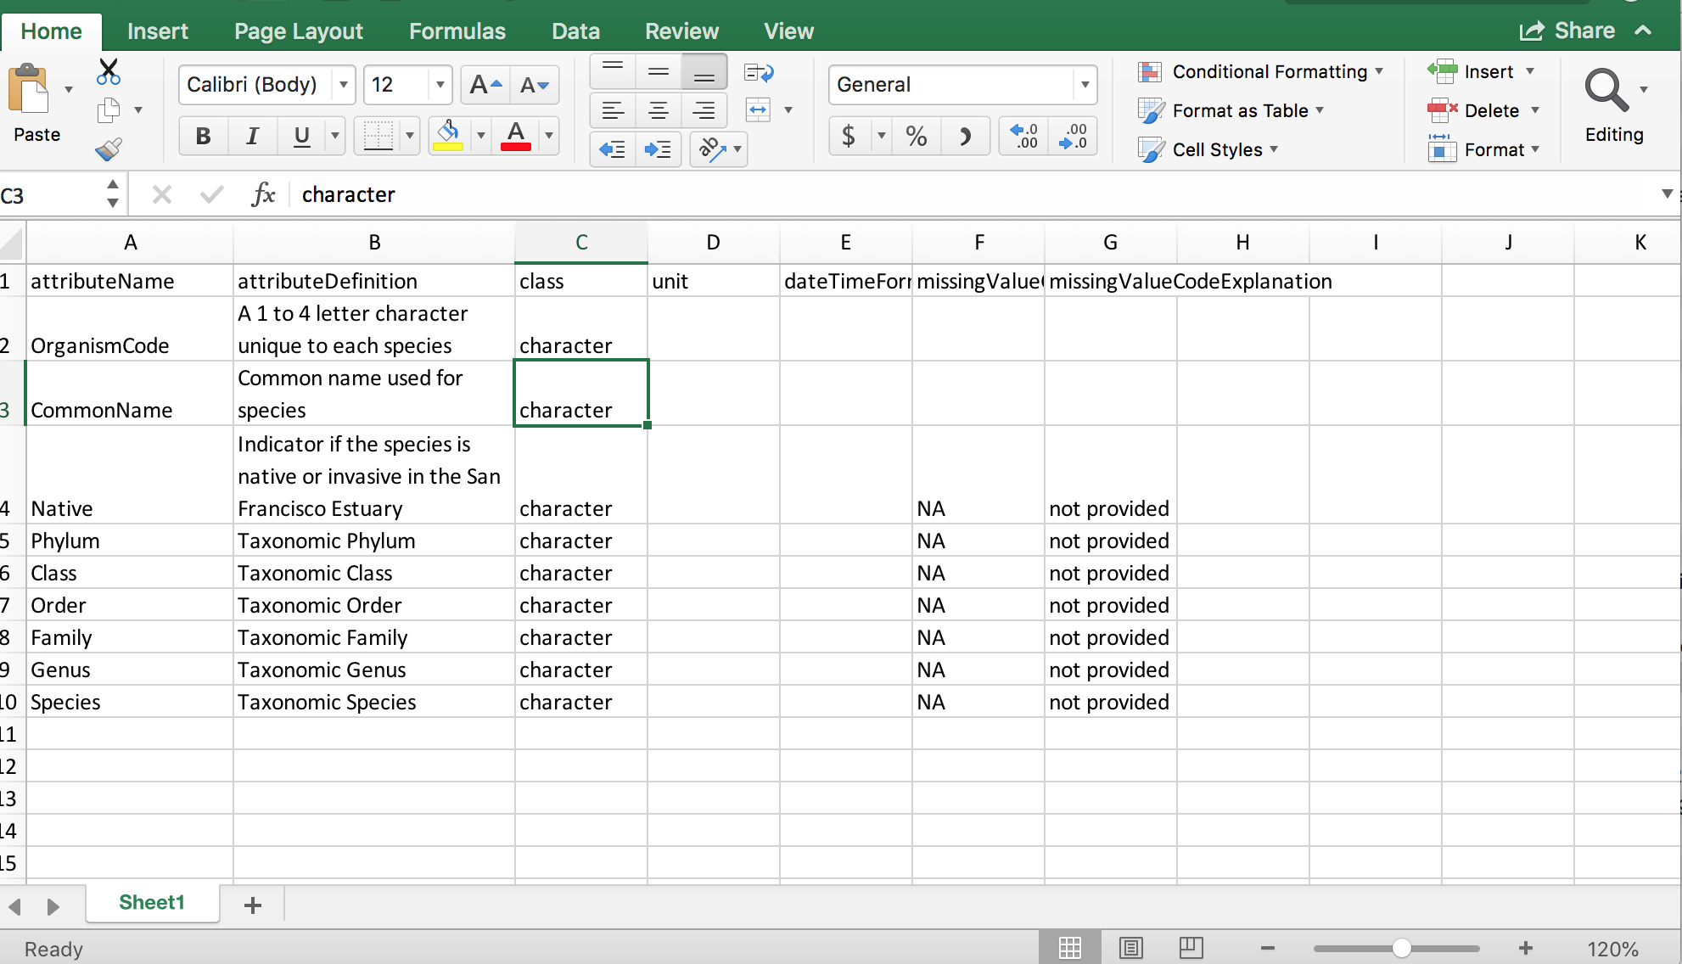
Development: EMLassemblyLine in R
Step 12: Attributes
Fish & water quality table
Custom units
Fish taxonomy table

Slide 17
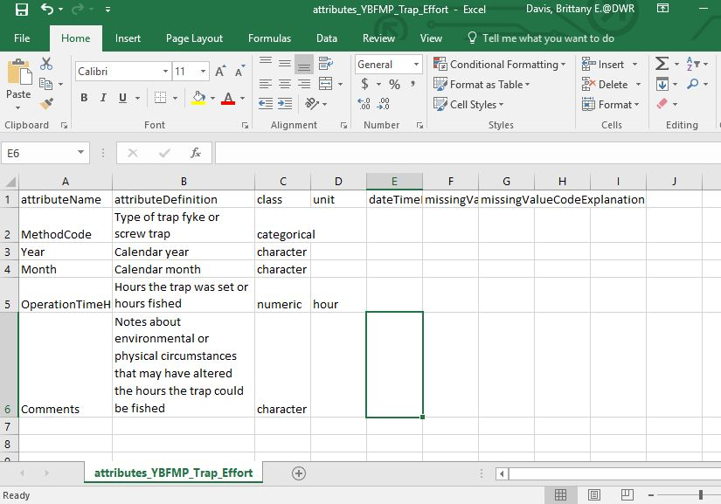
Development: EMLassemblyLine in R
Step 12: Attributes
Fish & water quality table
Custom units
Fish taxonomy table
Trap Effort table

Slide 18
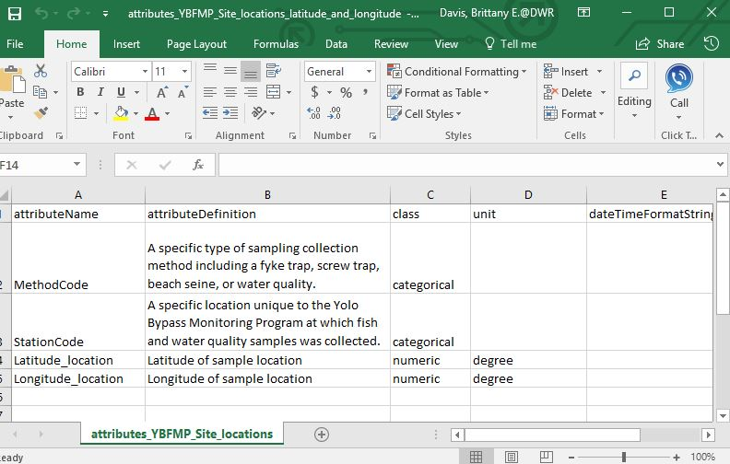
Development: EMLassemblyLine in R
Step 12: Attributes
Fish & water quality table
Custom units
Fish taxonomy table
Trap Effort table
Site location table

Slide 19
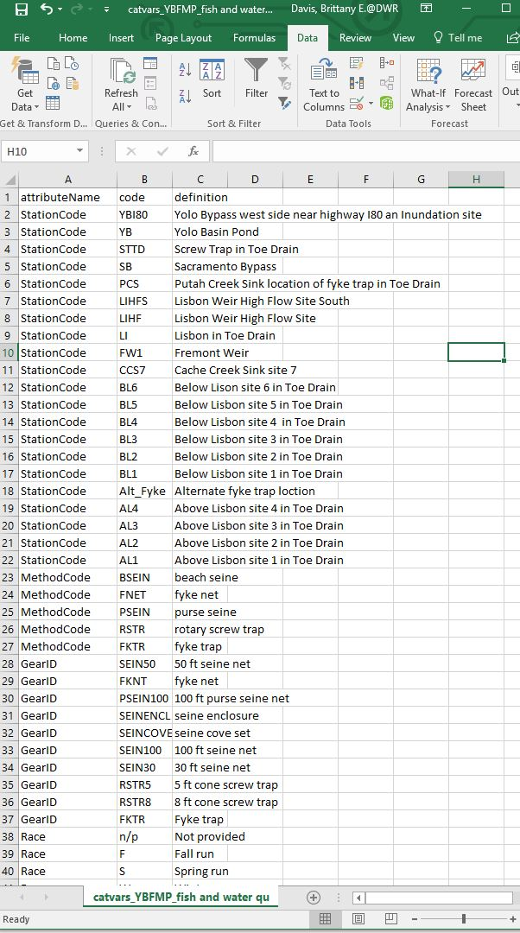
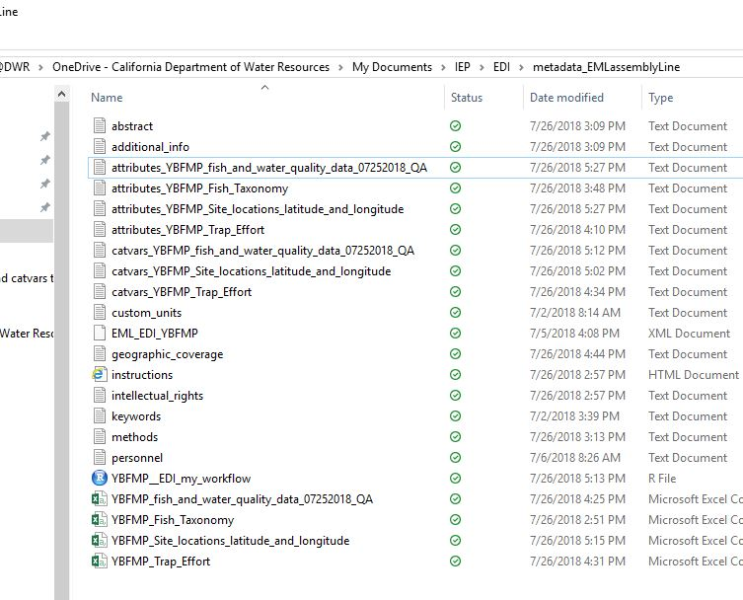
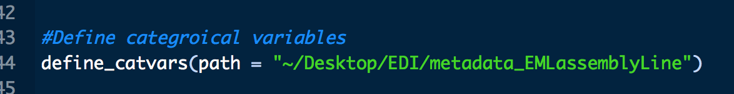
Development: EMLassemblyLine in R
Step 13: Close Files
Step 14: Categorical Variables
Notes:
Step 13: Close files, if any of your files are open code will not generate catvars
Step 14: Categorical variables
If your data tables contain any attributes with the categorical class, you will need to supply definitions for the categorical codes. Use the function define_catvars to do this. define_catvars searches through each attribute file looking for attributes with a categorical class. If found, the function extracts unique categorical codes for each attribute and writes them to a file for you to define.
# View documentation for this function
?define_catvars
# Run this function for your dataset
define_catvars(path = "/Users/csmith/Desktop/gleon_chloride")
A tab delimited catvars_datatablename.txt will be created for each of your data tables containing categorical variables. Open these in a spreadsheet editor and add definitions for each code.

Slide 20
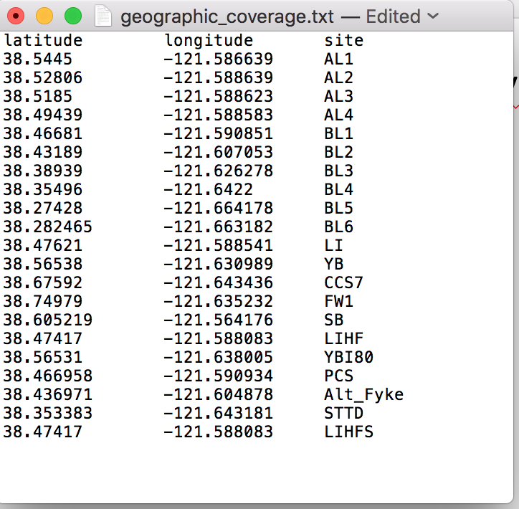
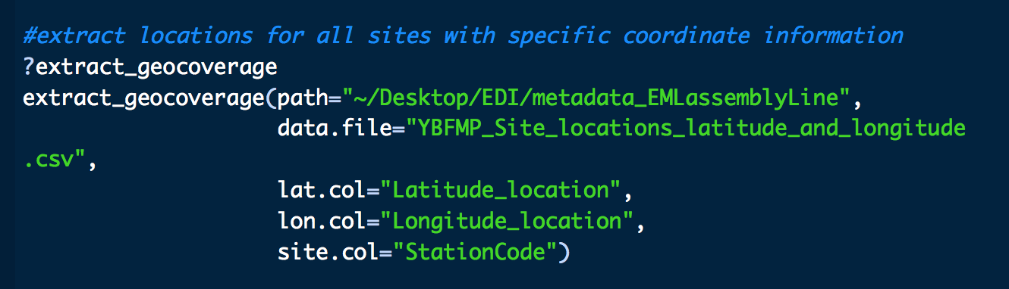
Development: EMLassemblyLine in R
Step 15: Geographic Coverage
Bounding box only for multiple regions, geo_cov for multiple sites in 1 regions
Notes:
Geographic points
Run the function extract_geocoverage to get the unique latitude, longitude, and site name combinations from your data and write to file. extract_geocoverage requires specific inputs that may require altering the latitude and longitude formate of your data. See documenation for details.
Arguments required by this function are:
path A path to the dataset working directory containing the data table with geographic information.
data.file Name of the input data table containing geographic coverage data.
lat.col Name of latitude column. Values of this column must be in decimal degrees. Latitudes south of the equator must be prefixed with a minus sign (i.e. dash, "-").
lon.col Name of longitude column. Values of this column must be in decimal degrees. Longitudes west of the prime meridian must be prefixed with a minus sign (i.e. dash, "-").
site.col Name of site column. This column lists site specific names to be associated with the geographic coordinates.
# View documentation for this function
?extract_geocoverage
# Run this function for your dataset
extract_geocoverage(path = "/Users/csmith/Desktop/gleon_chloride",
data.file = "lake_characteristics.csv",
lat.col = "lake_latitude",
lon.col = "lake_longitude",
site.col = "lake_name")
This function outputs a tab delimited file named geographic_coverage.txt to your dataset directory. You may edit this in a spreadsheet editor if you'd like, but if the data table this information has been extracted from is accurate, then there is no need for editing.
**The bounding box text file is for multiple regions. For Yolo Bypass we have one general region (YB) with numerous sampling sites. So we’ll use geographic coverage as a single entry and delete the bounding box file in the working directory. If you leave the bounding boxes if will give you a replication ERROR and not run the xml.

Slide 21
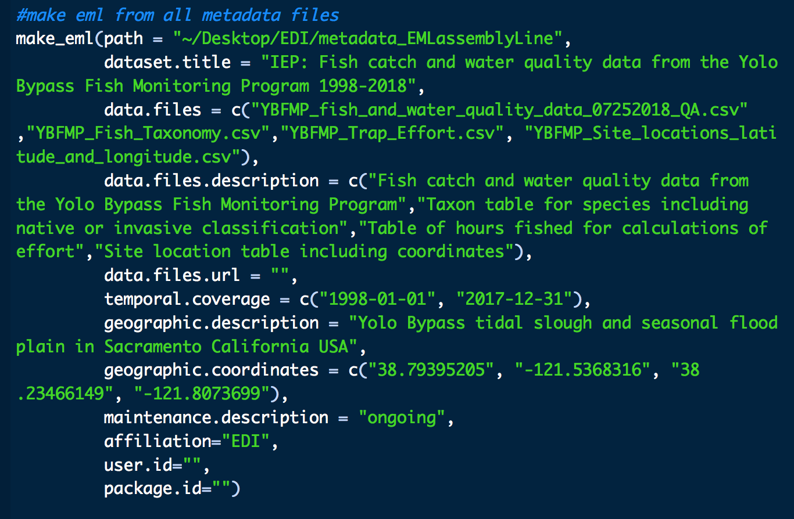
Development: EMLassemblyLine in R
Step 16: Make EML !
Notes:
Step 16: Make EML
Now you are ready to synthesize your completed metadata templates into EML. This step is relatively simple, but requires several arguments:
path A path to the dataset working directory.
dataset.title A character string specifying the title for your dataset. Be descriptive (more than 5 words). We recommend the following format: Project name: Broad description: Time span (e.g. "GLEON: Long term lake chloride concentrations from North America and Europe: 1940-2016").
data.files A list of character strings specifying the names of the data files of your dataset.
data.files.description A list of character strings briefly describing the data files listed in the data.files argument and in the same order as listed in the data.files argument.
data.files.quote.character A list of character strings defining the quote characters used in your data files and in the same order as listed in the data.files argument. If the quote character is a quotation, then enter "\"". If the quote character is an apostrophe, then enter "\'". If there is no quote character then don't use this argument when running make_eml.
data.files.url A character string specifying the URL of where your data tables are stored on a publicly accessible server (i.e. does not require user ID or password). The EDI data repository software, PASTA+, will use this to upload your data into the repository. If you will be manually uploading your data tables, then don't use this argument when running make_eml.
zip.dir A list of character strings specifying the names of the zip directories of your dataset.
zip.dir.description A list of character strings briefly describing the zip directories listed in the zip.dir argument and in the same order as listed in the zip.dir argument.
temporal.coverage A list of character strings specifying the beginning and ending dates of your dataset. Use the format YYYY-MM-DD.
geographic.coordinates A list of character strings specifying the spatial bounding coordinates of your dataset in decimal degrees. The list must follow this order: "North", "East", "South", "West". Longitudes west of the prime meridian and latitudes south of the equator are prefixed with a minus sign (i.e. dash -). If you don't have an area, but rather a point. Repeat the latitude value for North and South, and repeat the longitude value for East and West.
geographic.description A character string describing the geographic coverage of your dataset.
maintenance.description A character string specifying whether data collection for this dataset is "ongoing" or "completed".
user.id A character string specifying your EDI data repository user ID. If you don't have one, contact EDI (info@environmentaldatainitiative.org) to get one, or don't use this argument when running make_eml.
package.id A character string specifying the package ID for your data package. If you don't have a package ID, then don't use this argument when running make_eml. A non-input package ID defaults to "edi.101.1".
# View documentation for this function
?make_eml
# Run this function
make_eml(path = "/Users/csmith/Desktop/gleon_chloride",
dataset.title = "GLEON: Long term lake chloride concentrations from North America and Europe: 1940-2016",
data.files = c("lake_chloride_concentrations",
"lake_characteristics"),
data.files.description = c("Chloride concentration data.",
"Climate, road density, and impervious surface data."),
data.files.quote.character = c("\"", "\""),
temporal.coverage = c("1940-01-31", "2016-01-01"),
geographic.description = "North America and Europe",
geographic.coordinates = c("69.0", "28.53", "28.38", "-119.95"),
maintenance.description = "completed",
user.id = "csmith",
package.id = "edi.201.1")
Your EML file will be written to your data directory with the name packageID.xml. If your EML is valid you will receive the message: EML passed validation!. If validation fails, open the EML file in an XML editor and look for the invalid section. Often a minor tweak to the EML can be made manually to bring it into compliance with the EML schema.

Slide 22
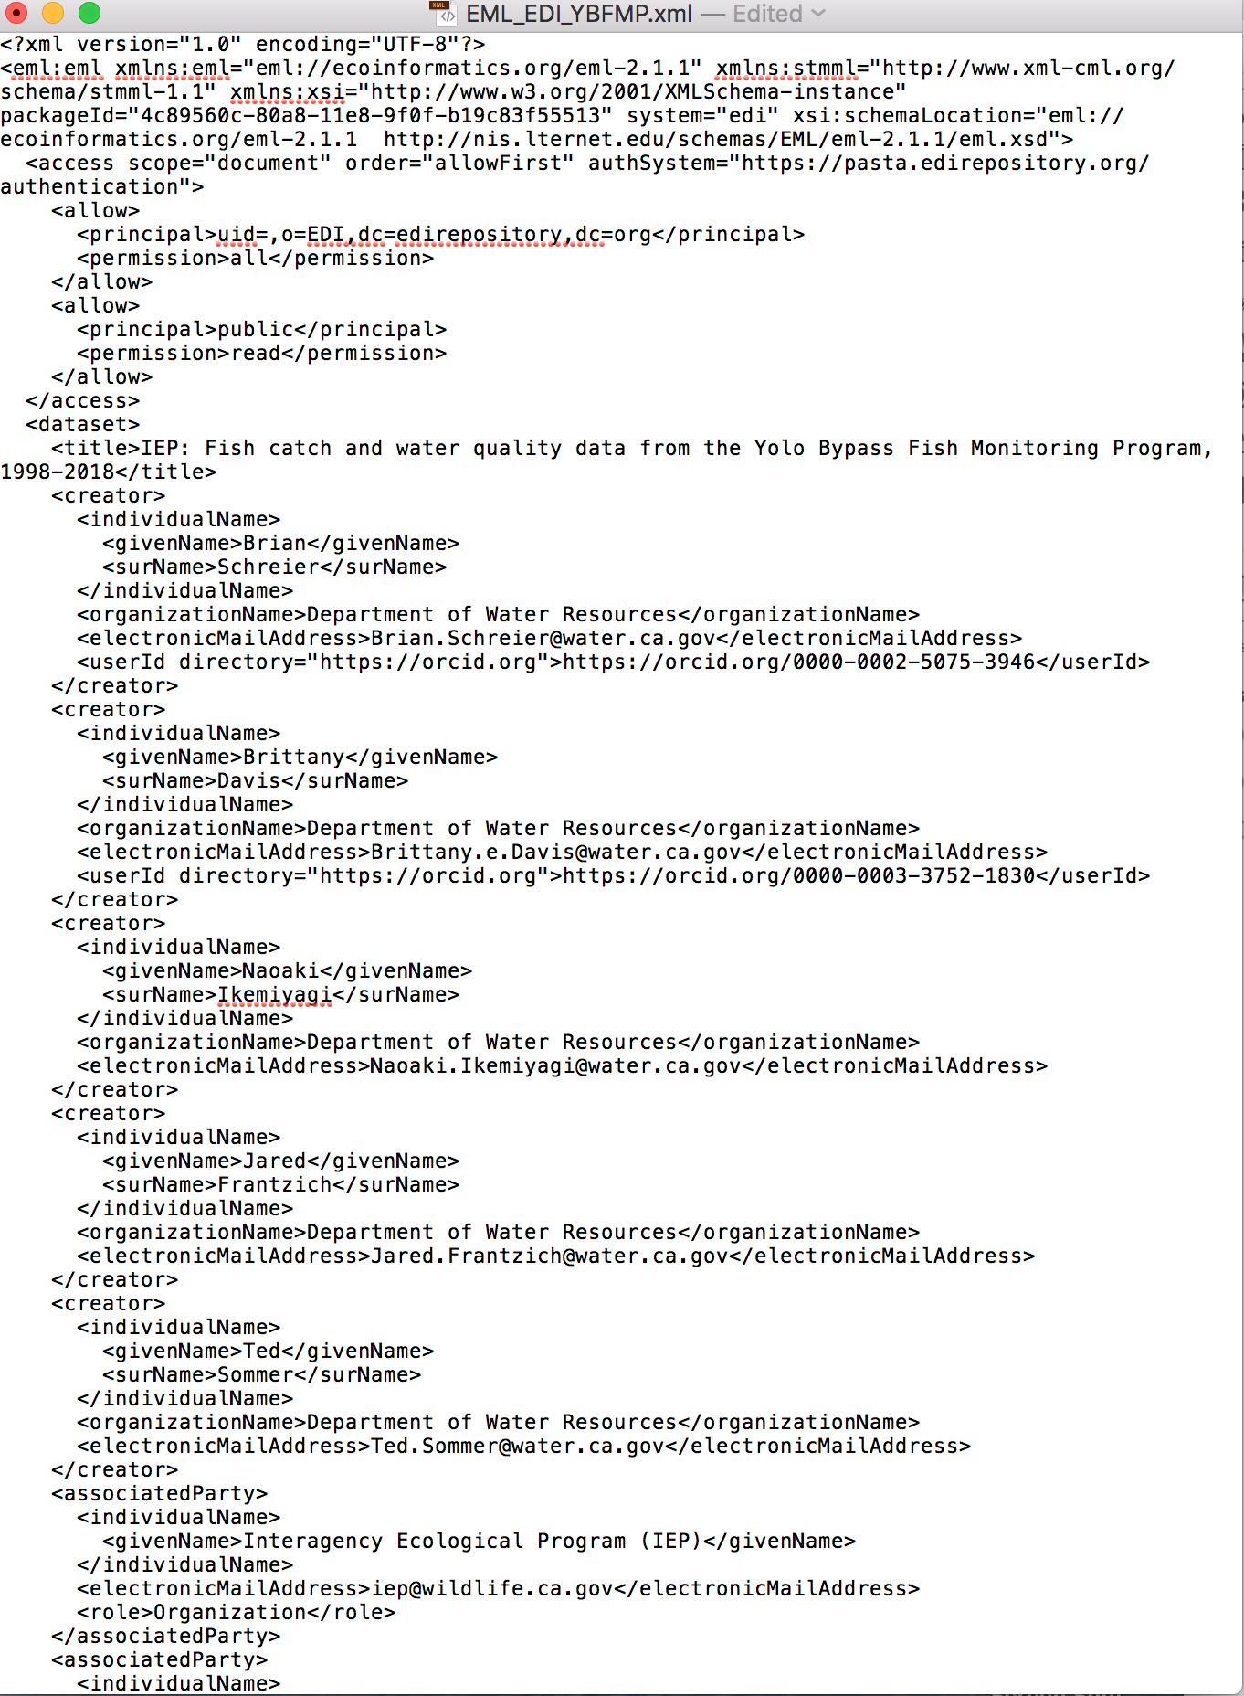
EML in xml

Slide 23
Two more steps to publish
Data Development
Staging
Publish
EMLassemblyLine
Do we want one login for all IEP or dataset-specific logins?
Notes:
Waiting for stagin login information. Staging is not public.
taken quite a while, weeks and can seem quite complicated or may get resistance from Pis.

Slide 24
Next-steps
Finalize metadata template (word document)
Suggested edits in document
Developing resources for next EDI/DOI test-case
DJFMP/USFWS: Brian Mahardja & Jonathon Speegle
Created an SOP for EMLassemblyLine with notes of how to fix error-corrections, and examples of R workspace from YBFMP.
Powerpoint & user support
https://github.com/EDIorg/EMLassemblyline
Video resources
EDI support
Need to evaluate if time and complexity can be reduced
Can evaluate after second test-case

Slide 25
Next-steps
Roles and Responsibilities for future of IEP dataset publications
DUWG (designated subgroup)
Agency data manager
?
IEP PI & data managers
Notes:
Can handle 8-12 datasets, with versioning

Slide 26
Next-steps
Roles and Responsibilities for future of IEP dataset publications
DUWG (designated subgroup)
Agency data manager
EDI curation support/ new online interface (2019)
?
IEP PI & data managers
EDI data curator team
Notes:
Can handle 8-12 datasets, with versioning

